Slide 1
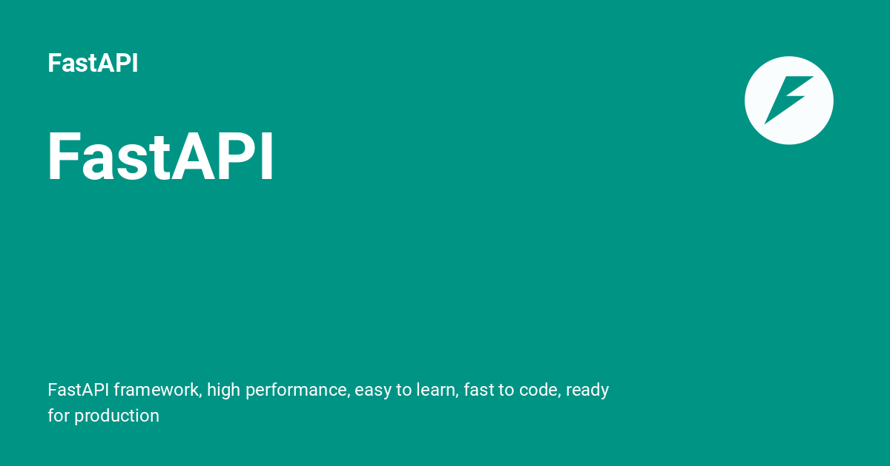

Slide 2
FastAPI?
FastAPI is a modern, high-performance web framework for building APIs using Python. It is built on top of:
Starlette → for web handling (requests, routing, etc.)
Pydantic → for data validation and serialization
It’s called FastAPI because it’s one of the fastest Python frameworks, comparable to Node.js and Go in performance.

Slide 3
Why FastAPI?
Feature | Description
High performance | One of the fastest Python frameworks (thanks to Starlette + async).
Auto-generated docs | Swagger (OpenAPI) and ReDoc docs generated automatically.
Security & OAuth2 | Built-in tools for authentication and authorization.
Type-safety | Uses Python type hints to validate and serialize data.
Minimal code | Fast to develop, easy to maintain.

Slide 4
Speed & Performance
FastAPI is built on Starlette and Pydantic, giving it best-in-class performance (on par with Node.js and Go --> comparable in performance and efficiency to Node.js and Go (Golang)).
Flask is synchronous and not designed for performance-critical apps.
Django is powerful but heavier and slower for API-only applications.
👉 FastAPI is ideal for modern, async, high-performance APIs.
2. Async Support
FastAPI uses async def natively – great for handling thousands of requests concurrently.
Flask needs gevent or quart for async.
Django supports async views from version 3.1+, but it's not fully async yet.
👉 For modern APIs that talk to async DBs (like MongoDB, async PostgreSQL), FastAPI shines.

Slide 5
3. Dependency Injection System:
FastAPI has a robust dependency injection system that simplifies managing complex dependencies like database connections, authentication, and external services. Dependencies are automatically injected into route functions.
4. Authentication and Authorization:
FastAPI provides built-in support for various authentication methods, including JWT tokens, OAuth2, and API key validation. It also offers authorization decorators to control access to different parts of your API.
5. Validation and Query Parameter Handling:
FastAPI performs automatic validation of query parameters, path parameters, request bodies, and headers based on type hints. It also handles query parameters, allowing you to define optional and required parameters effortlessly.

Slide 6
7. Automatic Interactive API Docs
FastAPI automatically generates Swagger and ReDoc documentation via OpenAPI.
Flask needs Flasgger or other plugins.
Django REST Framework supports Swagger via third-party tools, but setup is heavier.
👉 FastAPI offers full auto-docs out of the box – great for teams & clients.
8. Developer Experience
FastAPI is built around modern Python (3.7+) and encourages clean, concise code.
Flask is minimalist but lacks tooling unless extended.
Django is great for large apps but has a steep learning curve.
👉 FastAPI = modern, minimal, powerful developer experience.

Slide 7
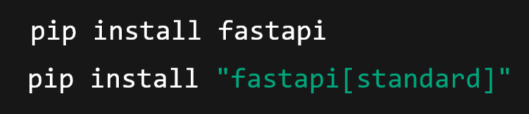
Your First FastAPI App: Hello FastAPI!
Step 1: Install FastAPI
Package | What it Installs | Description
fastapi | Only the core FastAPI framework | Minimal installation — you get just FastAPI itself. You’ll need to manually install other tools like a web server (uvicorn) if you want to run the app.
fastapi[standard] | FastAPI plus recommended extras | Includes FastAPI and additional useful dependencies like uvicorn, python-multipart, jinja2, itsdangerous, and email-validator. It’s a full development setup ready to run and handle forms, uploads, templates, etc.

Slide 8
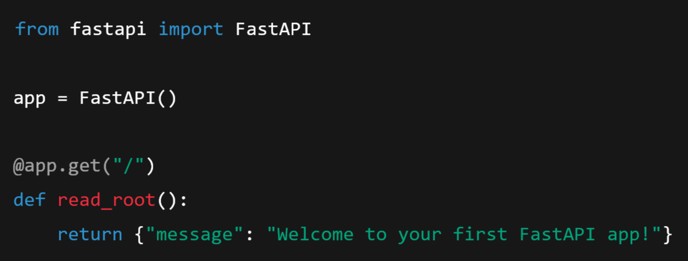
Step 2: Create a Python file main.py

Slide 9
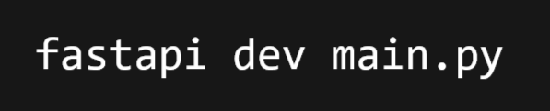

Step 3: Run the app using FastAPI:
You need to pip install fastapi[standard], then run directly using the FastAPI CLI (no need to type uvicorn manually):
This:
Runs the app with auto-reload (Live Server)
Uses uvicorn internally
Shows the local server URL (usually http://127.0.0.1:8000)

Slide 10
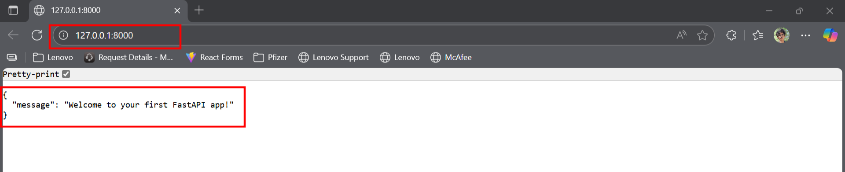
Open the Server Domain (localhost) in Browser:
Output in Browser:

Slide 11
FastAPI Swagger UI:
In FastAPI, /docs is an automatically generated interactive API documentation page provided by Swagger UI.
Here’s what it does:
Interactive UI: Lets you see all your API endpoints, their HTTP methods (GET, POST, etc.), request parameters, and response formats.
Try it out: You can call your API directly from the browser without writing any client code.
Auto-generated: FastAPI reads your route definitions and Pydantic models to generate the docs automatically.
Based on OpenAPI: FastAPI follows the OpenAPI standard, so /docs is a UI over the OpenAPI spec.

Slide 12
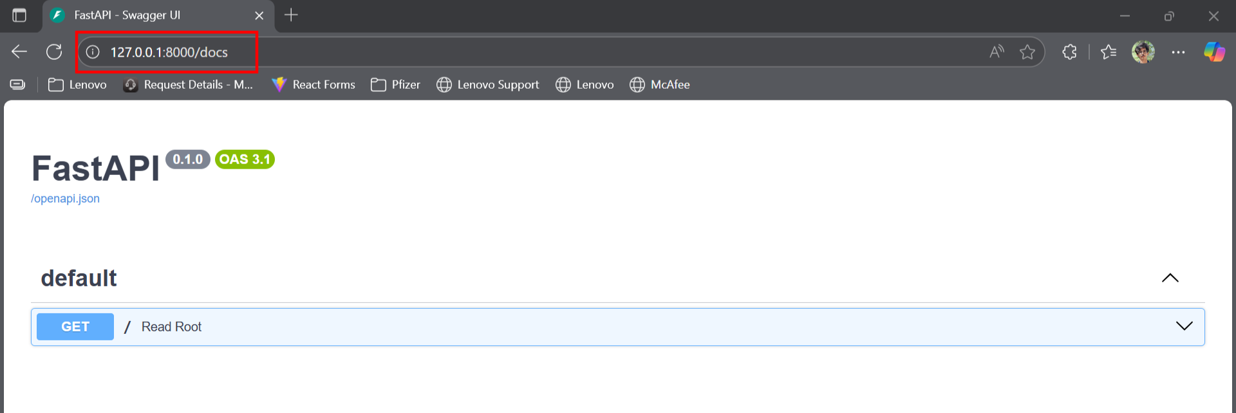
Example:

Slide 13
Python Web Servers and Web Applications/Frameworks
What is a Python Web Server?
A Python web server is a software tool that:
Listens for incoming requests from users (via HTTP, WebSocket, etc.)
Runs your Python web application
Returns responses back to the users
It acts as a bridge between web app (your code) and the outside world (internet or browser).

Slide 14
Common Python Web Servers:
Think of web servers like waiters that take your order (HTTP request), go to the kitchen (web app), and return your food (response).
Server | Interface | Used with
Gunicorn | WSGI | Flask, Django
uWSGI | WSGI | Flask, Django
Uvicorn | ASGI | FastAPI, Starlette
Hypercorn | ASGI | Django, FastAPI, etc.
Daphne | ASGI | Django Channels

Slide 15
What is a Python Web Application / Framework?
A Python web application is your actual Python code that defines:
Routes or endpoints (e.g., /login, /products)
Business logic (e.g., what to do when a user logs in)
Responses (e.g., JSON, HTML pages)
A framework helps build that application easily by providing tools like routing, templating, validation, etc.

Slide 16
Popular Python Web Frameworks:
Think of the framework as the kitchen, and your code is the recipe that cooks up responses for requests.
Framework | Interface | Type | Use Case
Starlette | ASGI | Lightweight async | Used under FastAPI
FastAPI | ASGI | Modern async framework | APIs with high performance
Flask | WSGI | Microframework | Lightweight APIs, websites
Django | WSGI/ASGI | Full-stack framework | Large websites, admin panel
Tornado | Custom | Async web server + app | Real-time apps

Slide 17
Putting it Together
When a user hits your website:
A web server (e.g., Uvicorn) receives the request.
It forwards the request to your application, written using a framework like FastAPI.
The app processes the request and sends back a response (like JSON or HTML).
The web server returns that response to the user.

Slide 18
What is ASGI? - Asynchronous Server Gateway Interface
It is a specification or interface between Python web servers and Python web applications/frameworks, designed to support asynchronous (async) capabilities as well as traditional synchronous ones.
Think of ASGI as the modern, async-friendly replacement of WSGI (Web Server Gateway Interface), which is used by older frameworks like Django (pre-3.0) and Flask.
What Does ASGI Do?
ASGI defines how a web server (like Uvicorn or Daphne) should interact with a web application (like FastAPI or Django Channels).
It handles:
Incoming HTTP requests
WebSocket connections
Background tasks
Long-lived connections
Streaming responses
Asynchronous communication

Slide 19
How ASGI Works (Simplified)
A user sends a request (HTTP/WebSocket).
An ASGI server (e.g., Uvicorn) receives the request.
It passes the request (as a Python dictionary with metadata) to the ASGI application callable.
The app processes the request and returns a response.
The ASGI server sends the response back to the client.

Slide 20
ASGI vs WSGI
Feature | WSGI | ASGI
Protocols | HTTP only | HTTP, WebSocket, more
Nature | Synchronous | Asynchronous + synchronous
Use Case | Traditional websites, APIs | Real-time apps, chat, async APIs
Server | Gunicorn, uWSGI | Uvicorn, Daphne, Hypercorn
Example Apps | Flask, Django (<3.0) | FastAPI, Starlette, Django (3.0+)

Slide 21

⭐ What is Starlette?
Starlette is a lightweight ASGI web framework for building high-performance async web applications in Python.
FastAPI is a child (or wrapper) of Starlette.
Or more technically: FastAPI is built on top of Starlette.
Starlette is a lightweight, asynchronous web framework for building high-performance APIs and web applications in Python.
It is the core foundation of FastAPI, meaning FastAPI is built on top of Starlette.

Slide 22
Key Features of Starlette:
Feature | Description
ASGI support | Fully asynchronous using ASGI (great for modern, real-time applications)
Fast | Designed for performance — handles thousands of requests concurrently
Modular | Minimalistic; lets you plug in only the components you need
WebSockets | Supports both HTTP and WebSockets out of the box
Testing utilities | Comes with built-in test clients for easy unit testing
Session & CORS | Middleware support for sessions, CORS, GZip, etc.
Routing | Powerful URL routing with path parameters

Slide 23
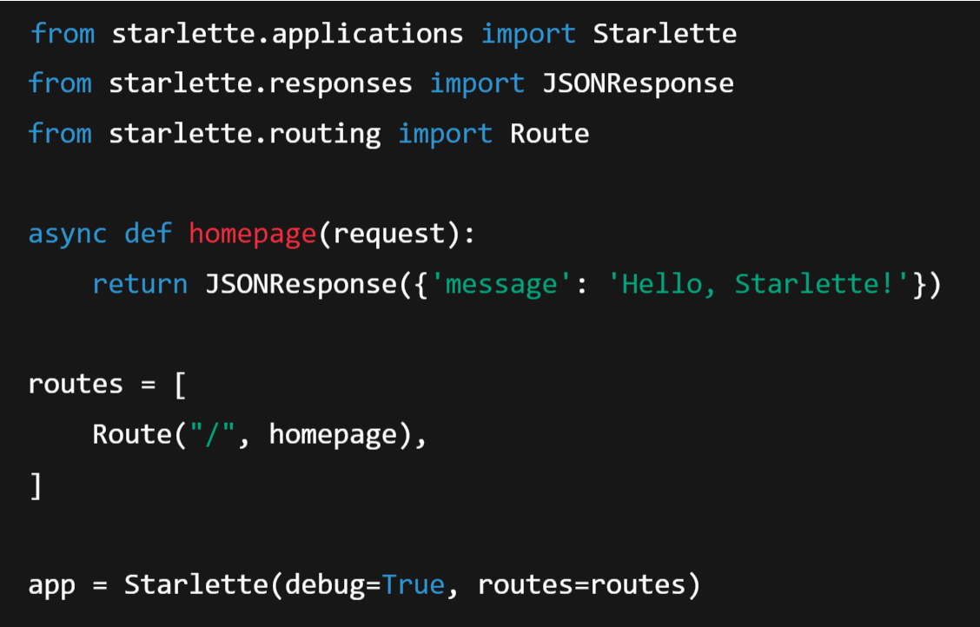


Example: Minimal Starlette App
Install starlette:
So with only Starlette, we can work one level closer to the ASGI layer.
Create the Application
Run the Application:

Slide 24
Starlette vs FastAPI
Note: Use Starlette if you want to build a web service or API from scratch, and FastAPI if you want auto validation, OpenAPI docs, and ease of use.
Aspect | Starlette | FastAPI
Type | Micro web framework | API framework built on Starlette
Input parsing | Manual (you handle requests) | Automatic (using Pydantic)
Validation | Manual (You write it yourself) | Built-in validation with decorators
Use case | Custom apps, middlewares, lower-level | High-level APIs, auto docs

Slide 25
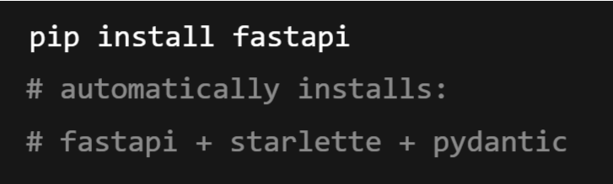
Relationship:
Starlette handles the core web parts: routing, middleware, WebSocket support, ASGI interface.
FastAPI adds features on top of Starlette:
Request validation using Pydantic
Automatic OpenAPI docs
Easy dependency injection
Declarative, high-level routing
You’ll Often See This in FastAPI Projects:

Slide 26
🏗️ FastAPI Architecture Overview
FastAPI is built on top of Starlette (for the web server) and Pydantic (for data validation). It’s designed to be fast, scalable, and easy to use with modern Python async features.
Underlying Tech Stack:
Layer | Component
Web server | Uvicorn / Hypercorn (ASGI servers)
ASGI framework | Starlette
Data validation | Pydantic
Core framework | FastAPI
Developer tools | Swagger Docs (OpenAPI), ReDoc

Slide 27
Request-Handling Lifecycle in FastAPI
Let’s walk through what happens when a client sends an HTTP request to a FastAPI app:
1. Client Sends Request
The client (browser, mobile app, Postman, etc.) makes an HTTP request: GET /items/42
The request goes to the ASGI web server like Uvicorn.
2. ASGI Server (Uvicorn)
Uvicorn receives the HTTP request and passes it to the FastAPI app via the ASGI protocol (Asynchronous Server Gateway Interface).
ASGI allows async concurrency, which is key to FastAPI’s performance.

Slide 28
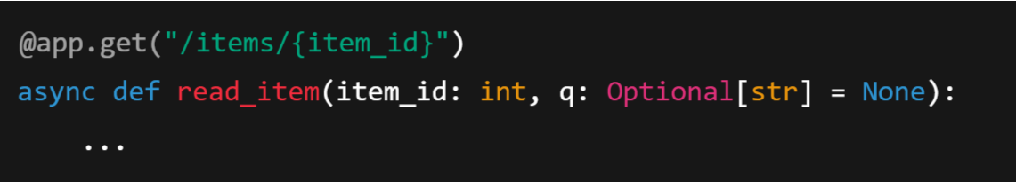
3. Starlette Handles Core Routing
FastAPI is built on Starlette, which:
Parses the request
Matches the route (/items/{item_id}) using the HTTP method
Prepares the request context (headers, query, path, etc.)
4. FastAPI Endpoint Matching & Dependency Injection
FastAPI matches the route with a function you defined:

Slide 29
FastAPI:
Extracts path and query parameters
Validates them using Pydantic
Injects them into your function as arguments
Injects other dependencies (e.g., DB session, auth token) if defined

Slide 30
5. Data Validation with Pydantic
All request data (body, query, path, headers) is parsed and validated using Pydantic models.
If validation fails, FastAPI returns a 422 Unprocessable Entity error with a detailed message.
6. Call the Endpoint Function
Your route handler function is called (async def read_item(...))
It may:
Fetch data from a database
Call an external API
Do computation
Return a response

Slide 31
7. Return Response
The response (usually a dict, Pydantic model, or JSON) is:
Automatically converted to JSON
Enriched with OpenAPI-compatible metadata
Sent back to the client with an appropriate HTTP status code
8. Interactive API Docs
FastAPI generates docs at:
/docs → Swagger UI
/redoc → ReDoc UI
These docs are auto-generated from your path, input/output types, and Pydantic models.

Slide 32
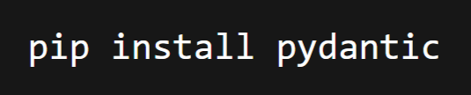
Pydantic:
Pydantic is a Python library used to validate and manage data using Python type hints.
It ensures that the data you receive (for example, from user input, API requests, or databases) is of the correct type and structure — automatically converting and validating it.
Installation:

Slide 33
Why Use Pydantic?
When writing code (especially APIs or data models), you often receive data like this:
But notice — "age" is a string, not an integer.
We can manually convert and check types… but that’s tedious.
Pydantic does this automatically — it will:
Convert data to correct types.
Validate missing or invalid fields.
Raise friendly errors if something’s wrong.

Slide 34
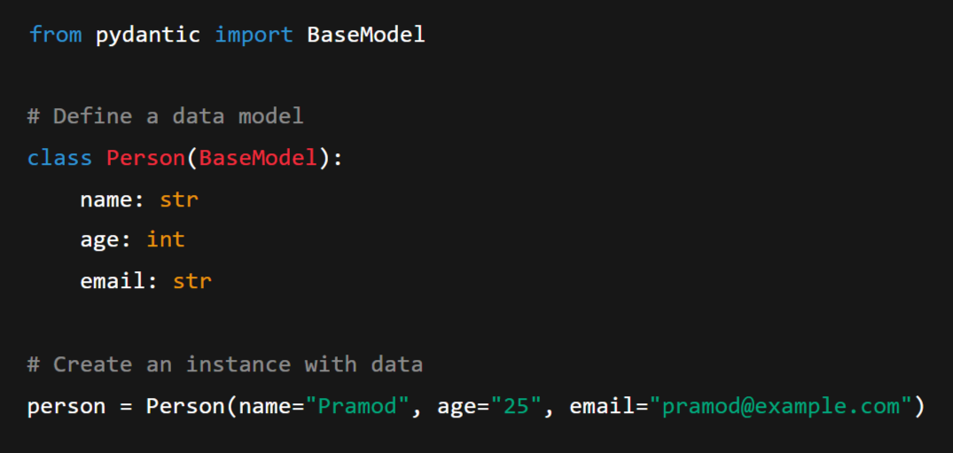
Basic Example:

Slide 35
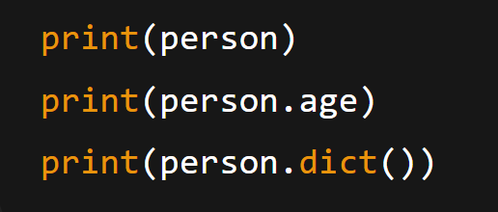
Now,
Notice that "age" was automatically converted to an integer!.
That’s data parsing and validation in action.

Slide 36
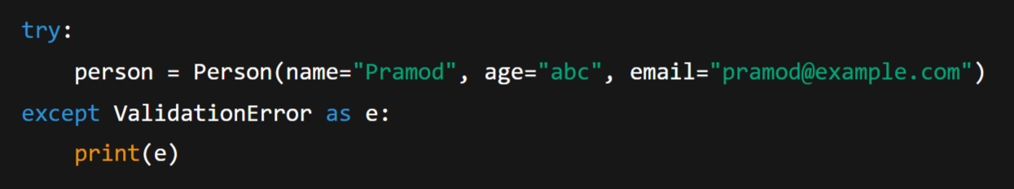
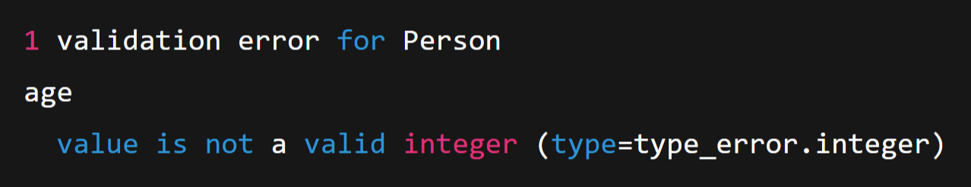
Handling Invalid Data:
Output:

Slide 37
BaseModel:
BaseModel is a class provided by Pydantic that allows you to define Python classes where:
Each attribute has a type annotation (like str, int, float, etc.)
Pydantic automatically validates that data assigned to those attributes matches the expected types.
You get automatic conversion, error handling, and JSON serialization for free.

Slide 38
Why Use It?
Because Python alone doesn’t enforce types at runtime because Python is Dynamically Typed.
For example:
But Pydantic will catch such mistakes at runtime and raise a ValidationError.

Slide 39


Extra Features of BaseModel
.dict() → Converts model to a Python dictionary:
.json() → Converts model to a JSON string:
.model_dump() and .model_dump_json() → (Pydantic v2 equivalents)
Validation and Error handling → ValidationError helps catch bad data cleanly.

Slide 40
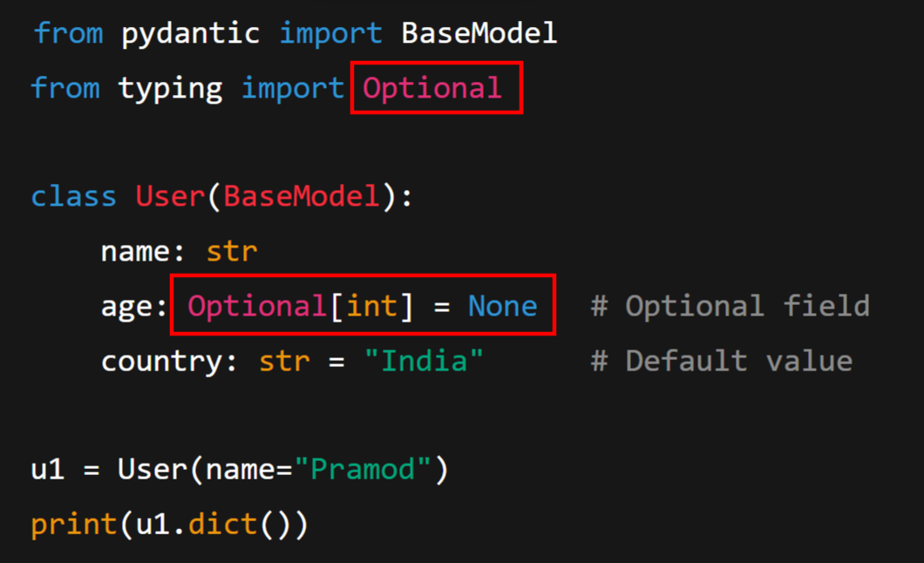
Default Values and Optional Fields:

Slide 41
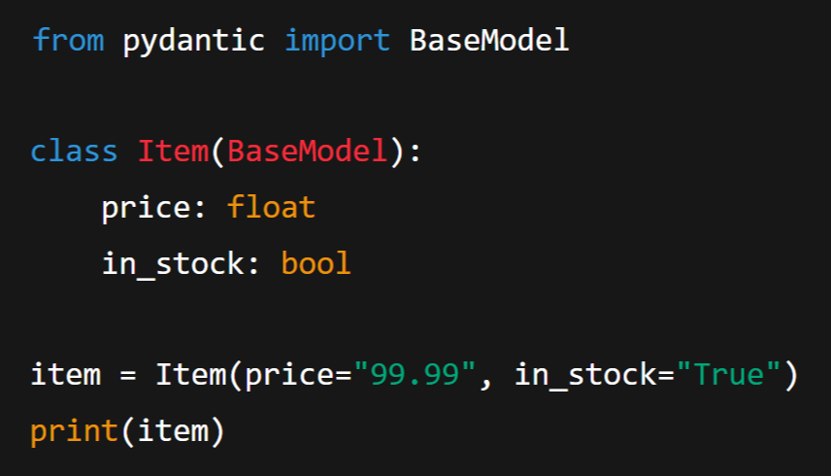
Data Conversion
Pydantic can coerce (convert) compatible data types automatically.

Slide 42
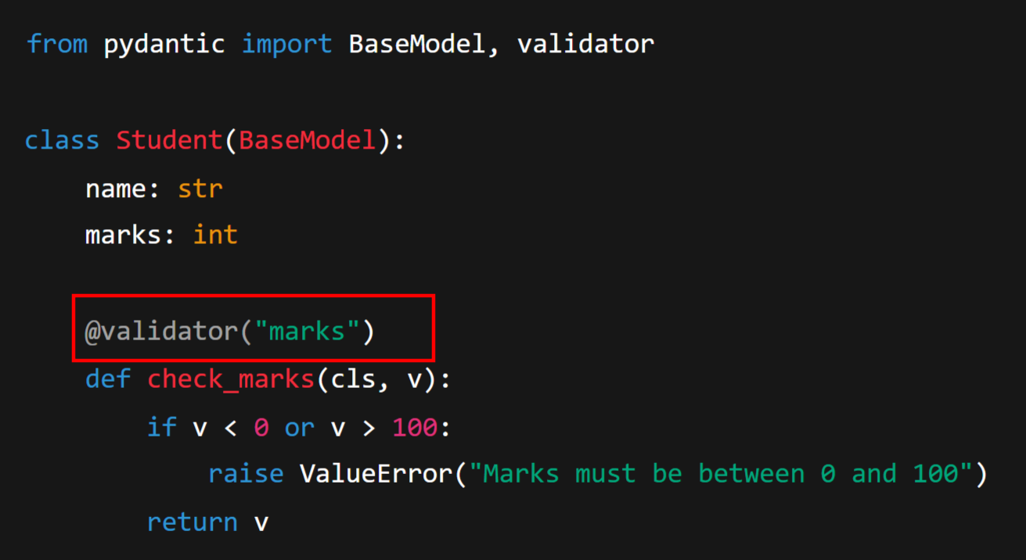
Validation with Custom Logic:
You can define validators to add your own rules.

Slide 43
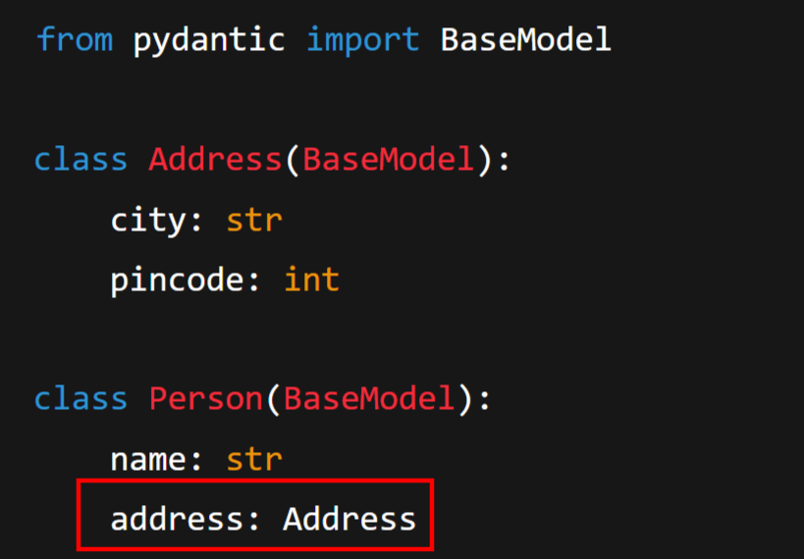
Nested Models
Pydantic models can be nested (useful for JSON-like data).

Slide 44
